Slide 1
Static Malware analysis
Itay Hacohen

Slide 2
Malware analysis - motivation
When analyzing a file we would like to achieve 2 main goals:
Is the file malicious? (detection and classification)
How it operates and what it does

Slide 3
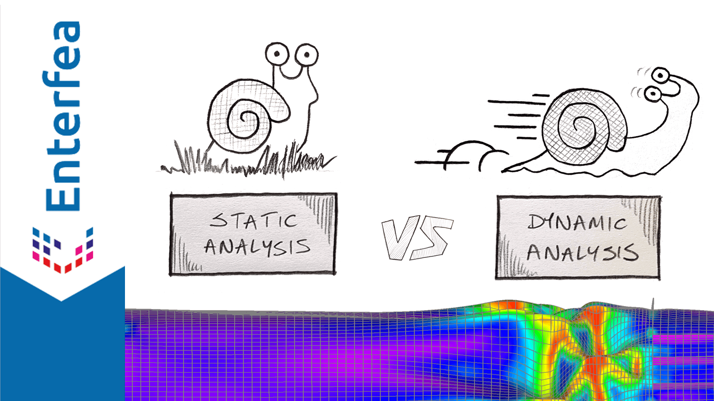

Slide 4
Static malware analysis - Techniques
Static techniques involve analysis of code without running the malware.
In static analysis there is no risk to the host machine.
Static analysis is FASTER
Hence - great for EP detection and for first analysis.

Slide 5
Static malware analysis - Uses
Uses of static analysis:
Find strings in code
Reverse engineer a piece of code (such as encryption function)
We will see other cool stuff :)

Slide 6
Dynamic malware analysis
Dynamic techniques analyse the behaviour of a malware.
Dynamic (behavioral) analysis attempts to answer:
How does the malware get installed?
What happens in the execution?
How does it run?
Does it connect to the internet?
Notes:
Slower to detect (postponing of execution).
Less secured.

Slide 7
Heads up!
We will only discuss static analysis in this lecture.
All the articles that I will be presenting have discussed both static and dynamic analysis techniques and results.

Slide 8
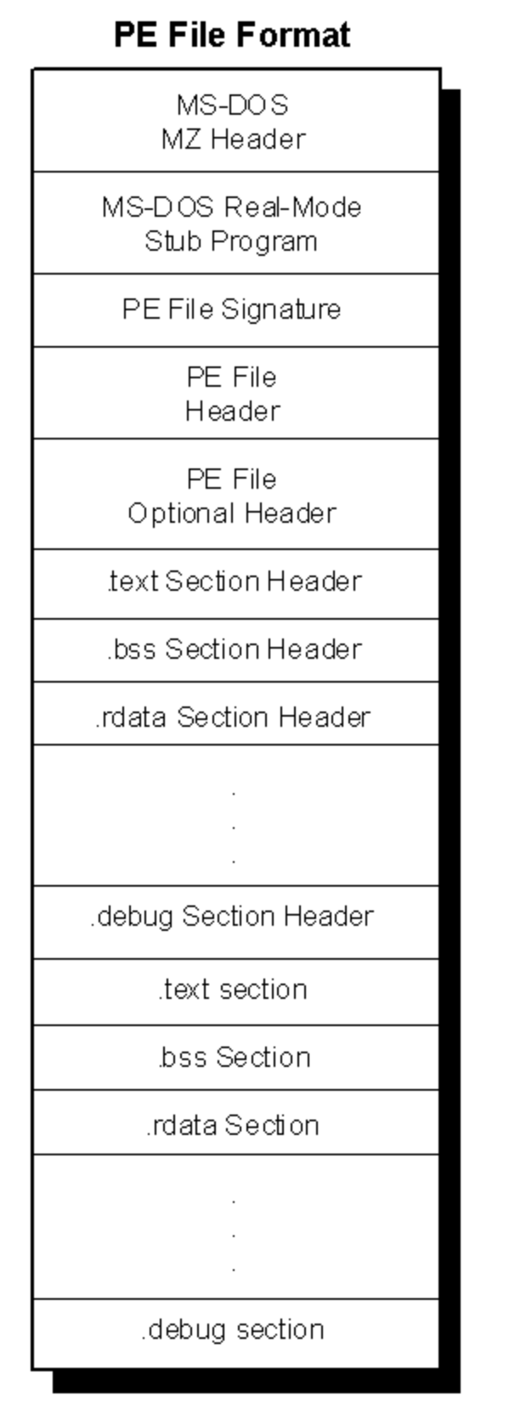
Introduction - PE files

Slide 9
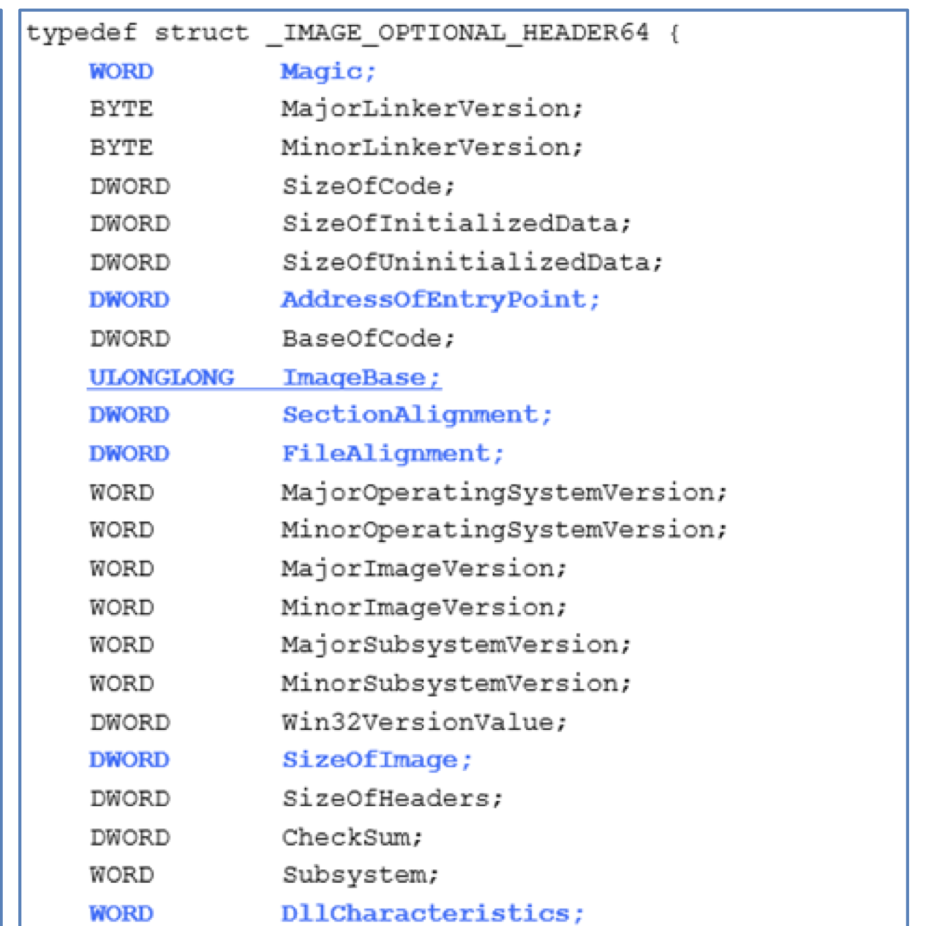
Introduction -
PE files -
Optional Header

Slide 10
Introduction - PE files - Sections
text - the section where the code instructions are stored.
data - variables with read-write permissions
rdata - read only variables
idata - contains the import address table
edata - contains the export address table

Slide 11
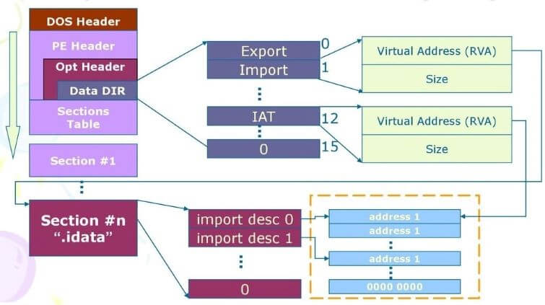
Introduction - PE files - Import Address table

Slide 12
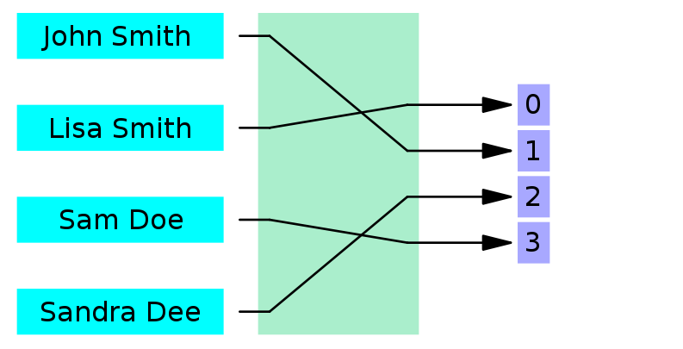
Malware static analysis - Hashing intro

Slide 13
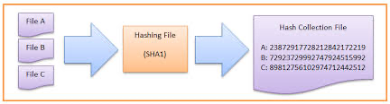
Malware static analysis - Hashing intro

Slide 14
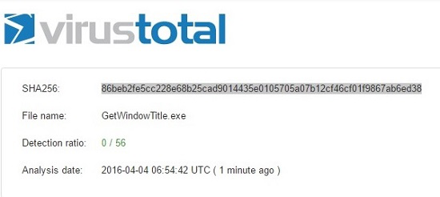
Malware static analysis - naive technique

Slide 15
Malware static analysis - 3 Techniques
Using Disassemblers and Analyzing the outcome using Classical MLA.
Analyzing the Raw Data and using deep learning algorithms.
Using DIMD (Deep Image Malware Detect) and using deep learning algorithms.

Slide 16
Using Disassemblers and Analyzing the outcome using Classical MLA.
1

Slide 17
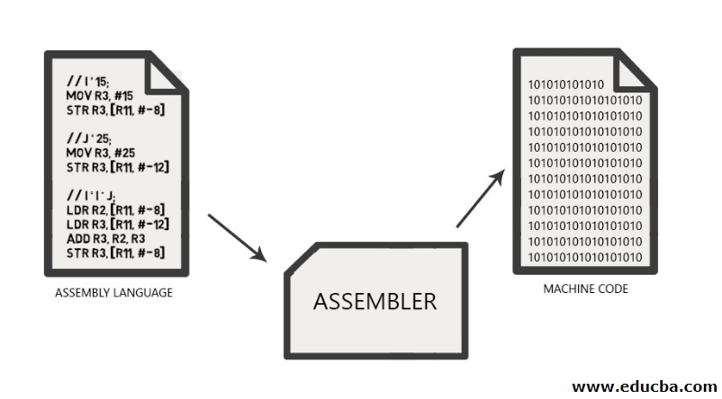

Slide 18
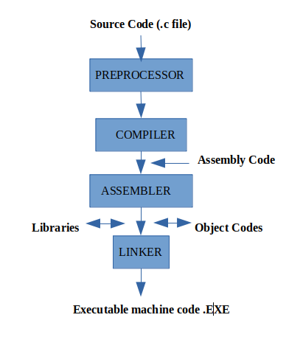
Introduction - compilers

Slide 19
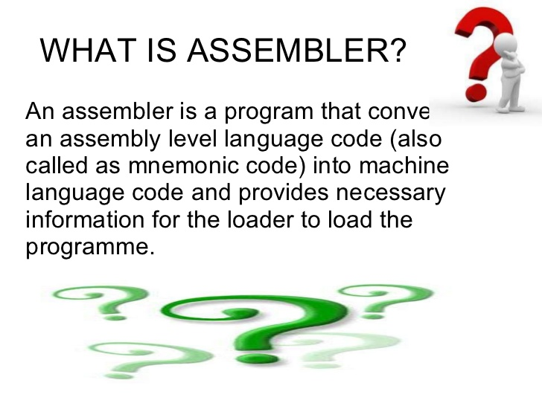
Introduction - assemblers

Slide 20
Can the work of the assembler be reverted?
Hint: disassemblers

Slide 21
What are disassemblers and how they work?

Slide 22
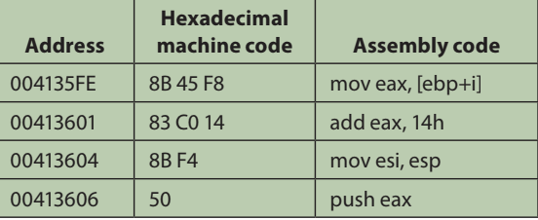
Linear sweep
Assumes that the binary executable code consists of several sections of continuous streams of binary code,
Decodes this consecutively.

Slide 23
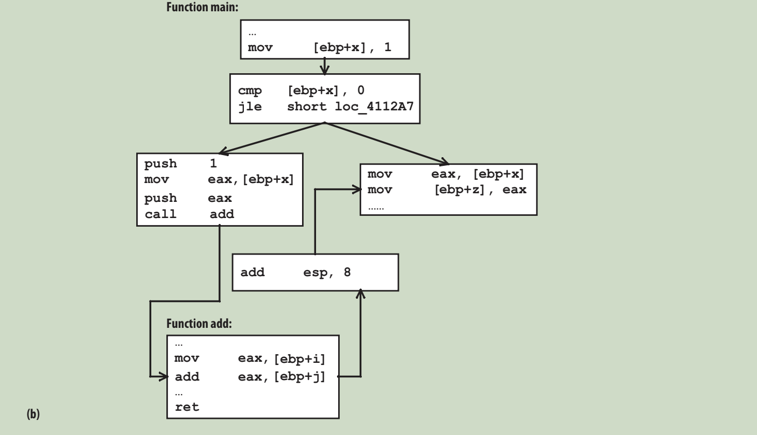
Control flow Graph

Slide 24
Comparing Histogram of binary code
To Classify architecture
Byte value histograms
Opcodes histograms
Other histograms (we will see)

Slide 25
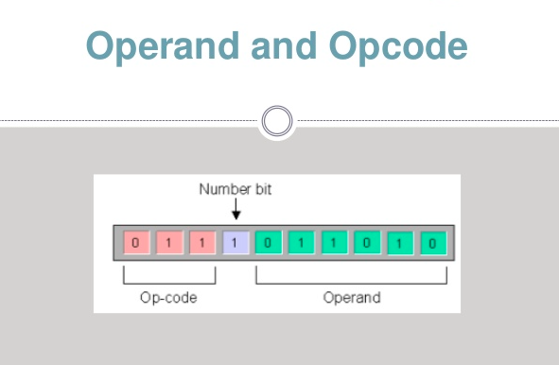
Static analysis Histograms and ML
Assembly instruction - what is it?
Operands VS Opcodes

Slide 26
Static Analysis - Malware classification
Let’s be more practical:
Feature extraction
Learning Classification Model
Classification of Unseen Binaries

Slide 27
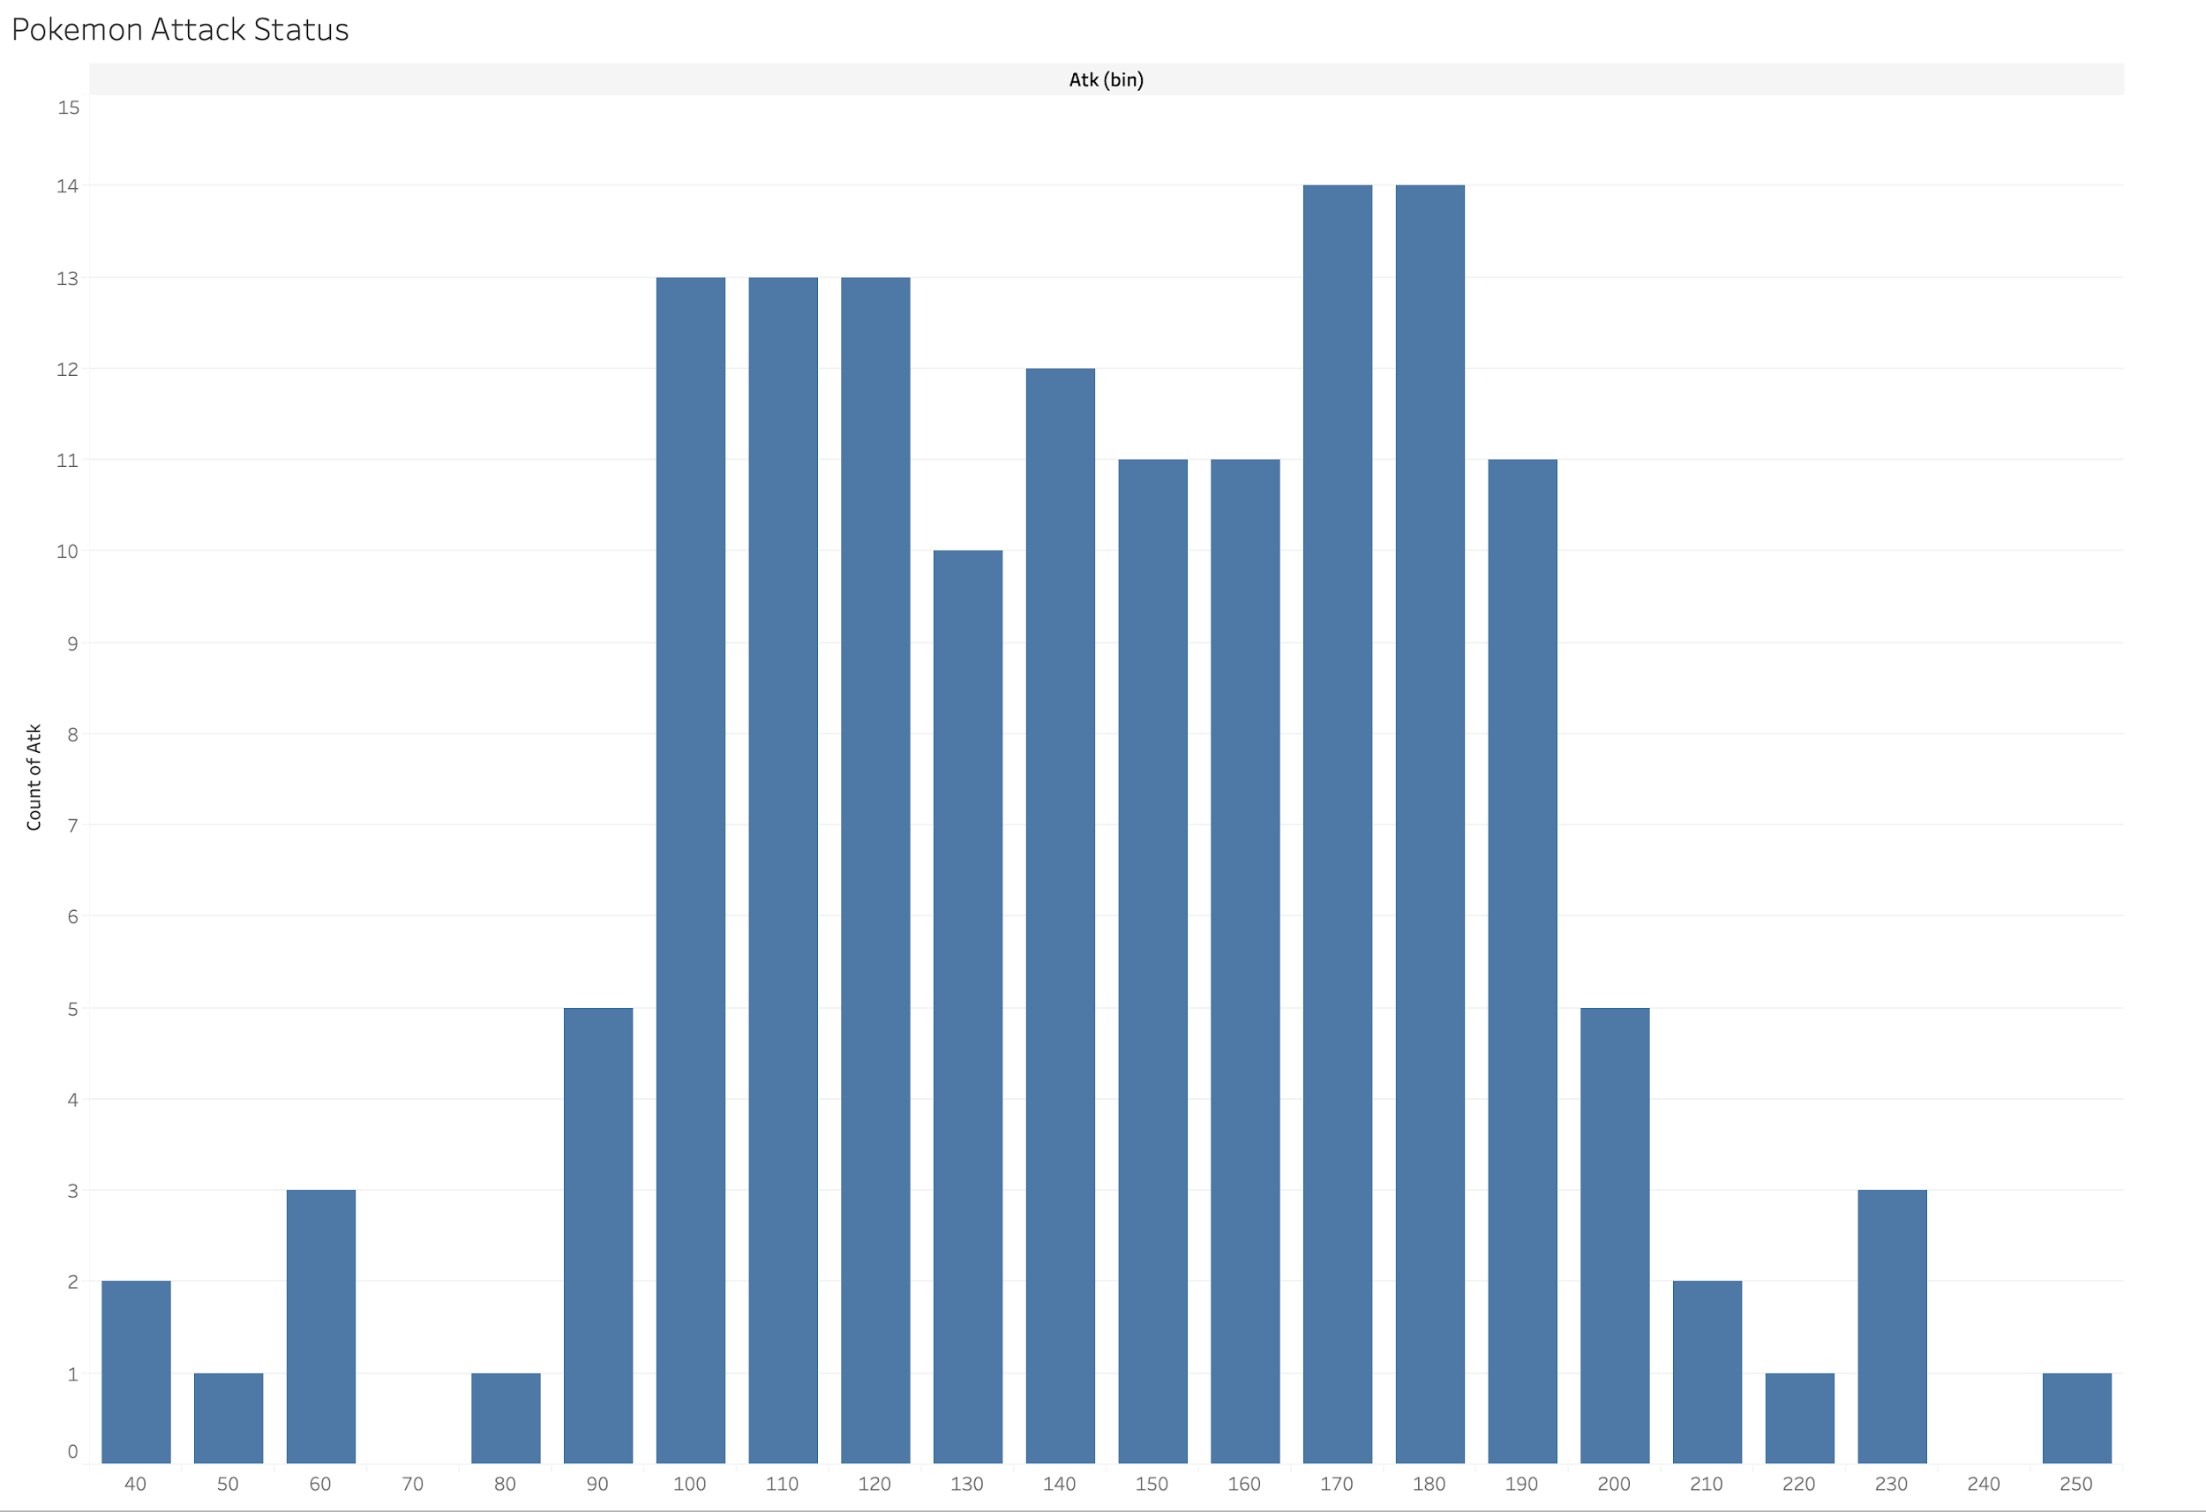
Feature Extraction
A - Assembly Instruction Frequency

Slide 28
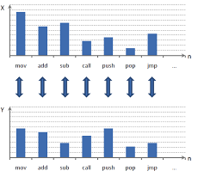
Feature Extraction
B - Instruction Opcode N-Grams
Cons:
The number of unique N- grams

Slide 29
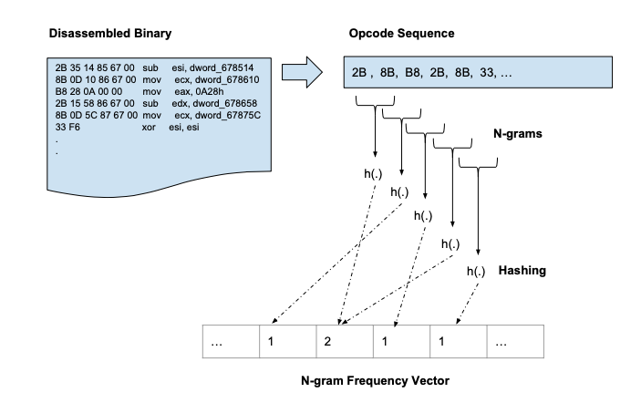
Feature Extraction
Possible solution: HASHING

Slide 30
Feature Extraction
C - Instruction Opcode N-Grams
Find logical “Delimiters”.
Construct N gram that starts with each such “delimiter”.
Only save shae hashes to reduce dimensionality.
Taking the structure of the code into account

Slide 31
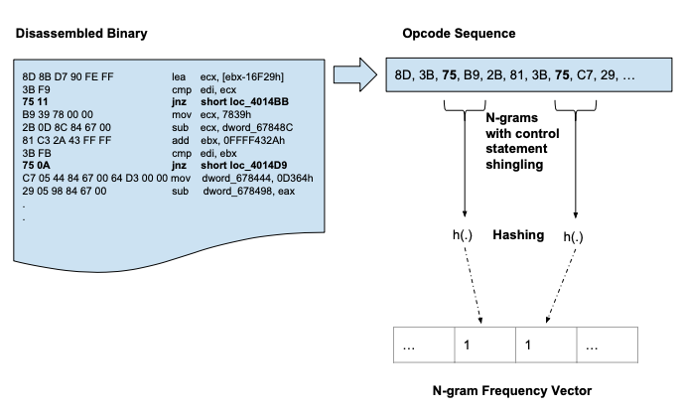
Feature Extraction

Slide 32
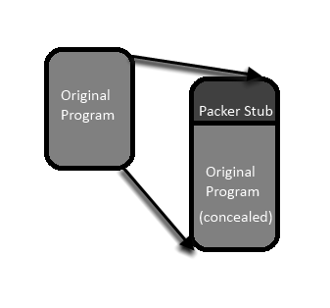
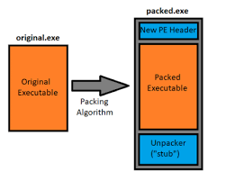
Feature Extraction - problem
New problem - Packers
Disassemblers will not help us - so what will?

Slide 33
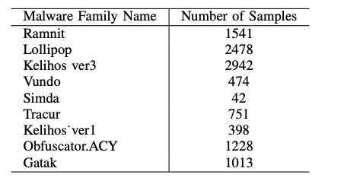
Feature Extraction
D - Import Address Table(DLL) Feature
Each malware/binary is represented by a vector of ones and zeros depending by the DLLs and function they import

Slide 34
Experiments and Results
Dataset:
10,867 labelled malware samples, which belong to 9 malware families.
Hashing:
Hash bit length when using feature hashing with n-gram features *
Trade-Off between: collisions, training time, N, and over fitting
*please see “Malware Classification Using Static Analysis Based Features” article under “experiments and results” for hash size optimization process.

Slide 35
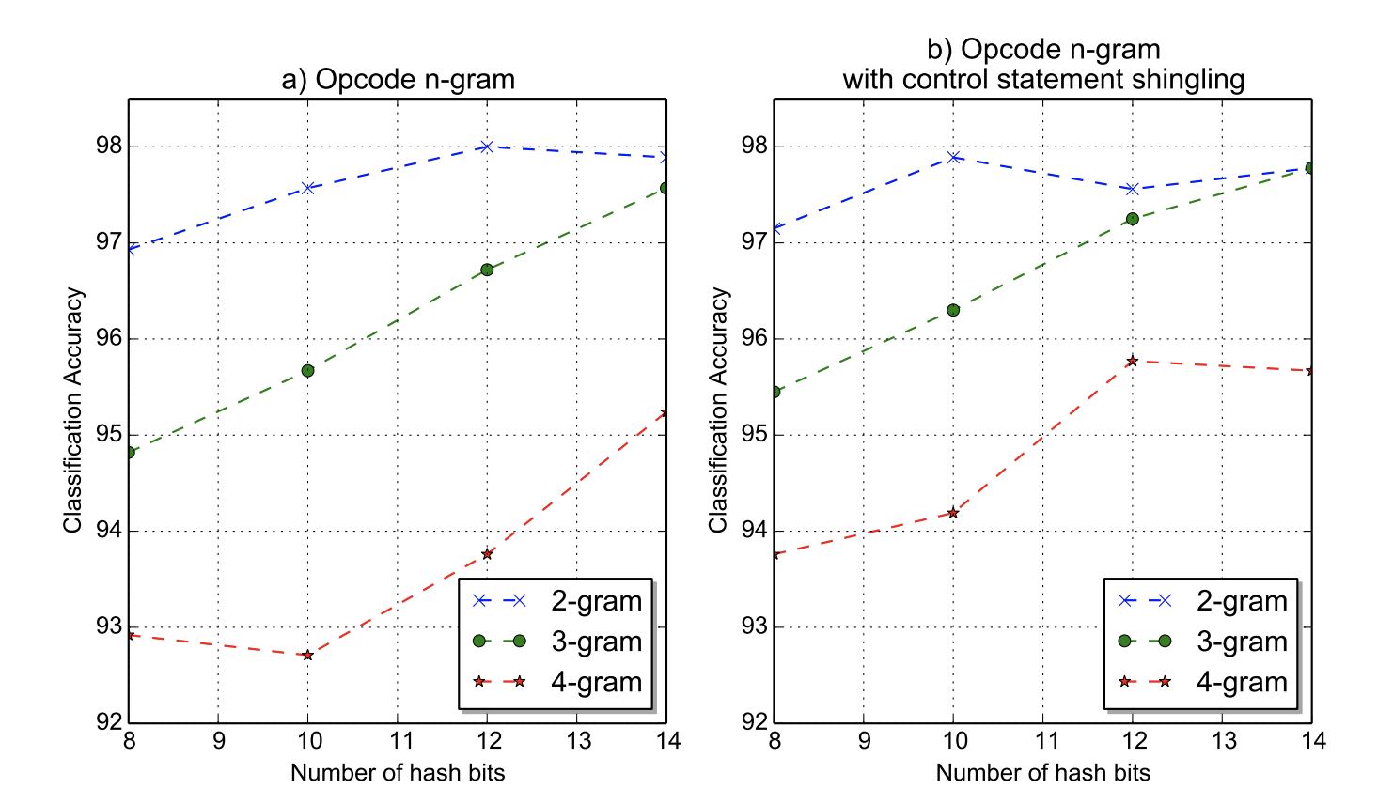
Experiments and Results

Slide 36
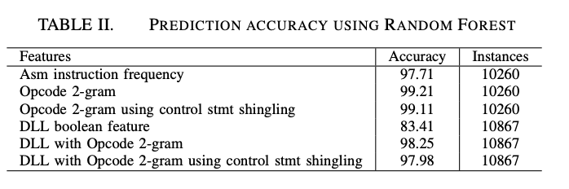
Experiments and Results

Slide 37
Experiments and Results
Can we go home?

Slide 38
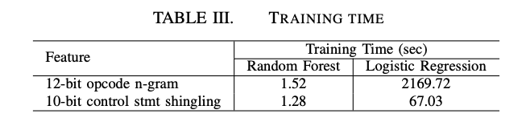
Experiments and Results
Training time

Slide 39
Limitations:
Packers
Limited to known malware families
Long time due to disassemblers (all except the Import table technique)
Can we get any better than this?

Slide 40
Static Analysis using Deep Learning
2
Using deep learning we can extract features to better classify PE (or binary) to benign and malicious.

Slide 41
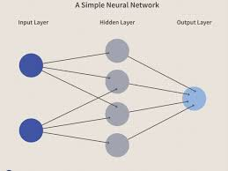
Static Analysis using Deep Learning -
Deep learning Intro

Slide 42
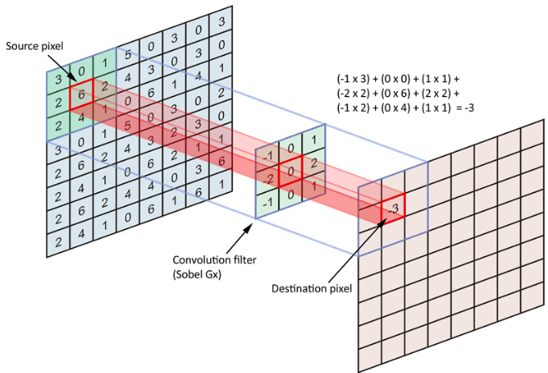
Static Analysis using Deep Learning -
CNN model

Slide 43
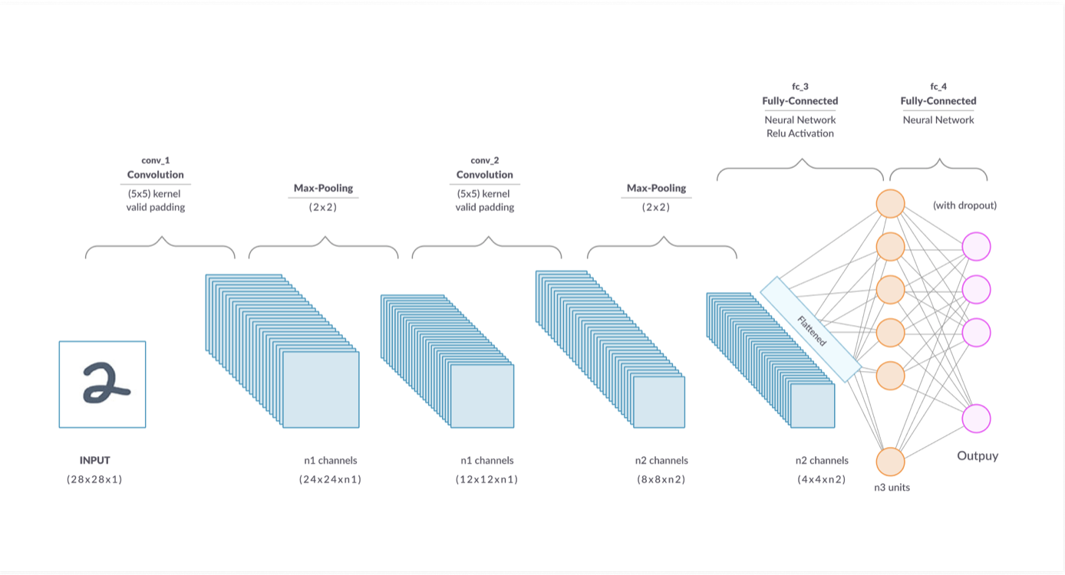
Static Analysis using Deep Learning -
Deep learning Intro

Slide 44
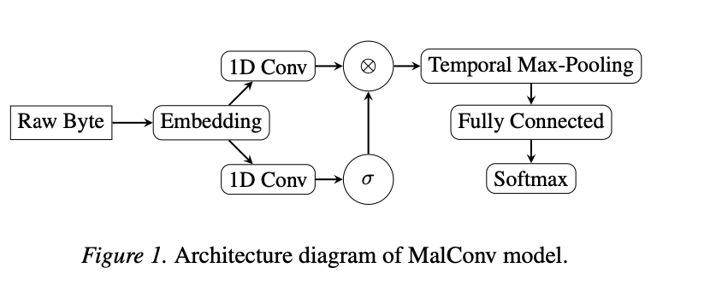
Static Analysis using Deep Learning

Slide 45
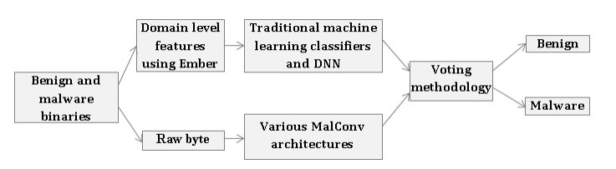
Static Analysis using Deep Learning

Slide 46
Static Analysis using Deep Learning
The Research: compare multiple machine learning algorithms in order to classify malwares
Ember dataset: contains 70,140 benign and 69,860 malicious files.
randomly divided into 60% training and 40% testing.

Slide 47
Limitations:
The Experiment: We run a short pre-processing on the file to extract PE features (can we guess which features?).
Then we used multiple MLA (machine learning algorithms) on that data:
Classical MLA : such as DNN, KNN, random forest etc
Advanced architecture for malware classification: MalConv neural network architecture and 3 other variants of the architecture.
Hybrid method of both classical MLA and MalConv neural network.

Slide 48
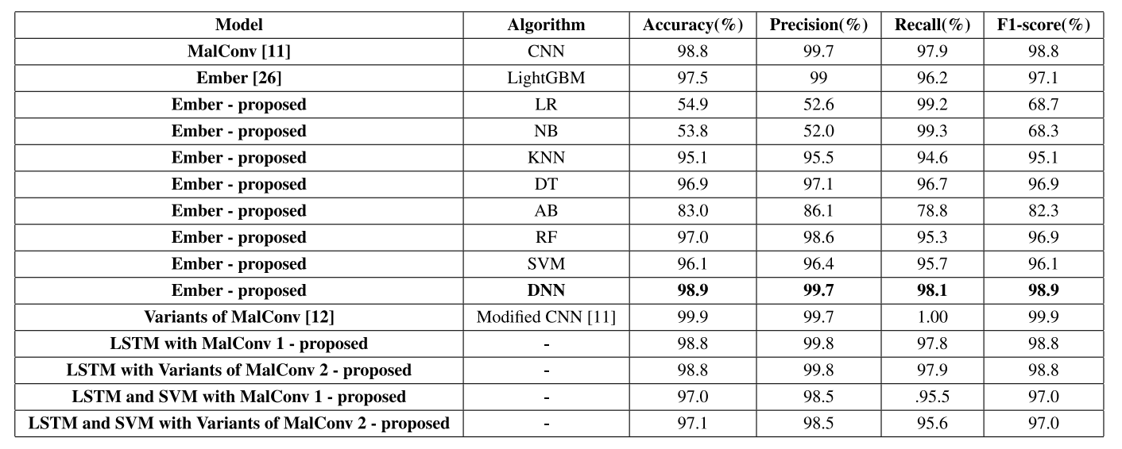
Results

Slide 49
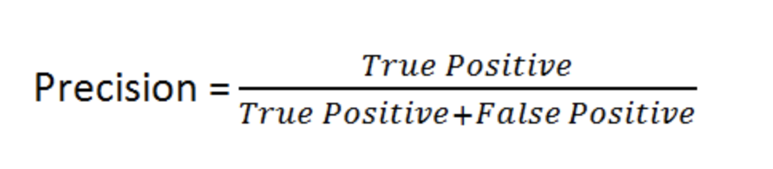
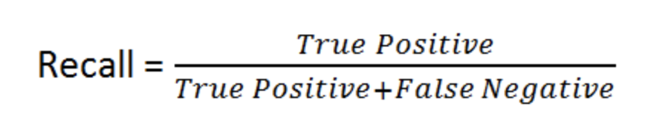
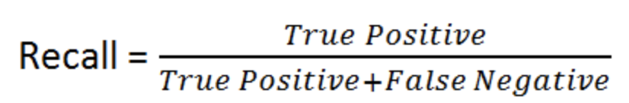
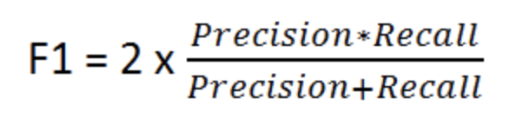
Results

Slide 50
Static Analysis using Deep Learning
Packers - can we fight back?

Slide 51
Malware family categorization using deep learning based on image detection.
3

Slide 52
Malware family categorization using deep learning based on image detection
Deep learning technologies for image processing is far more advanced
We convert the raw PE file in grayscale image.
Packed malware variants from the unpacked malware can contain visual similarity.

Slide 53
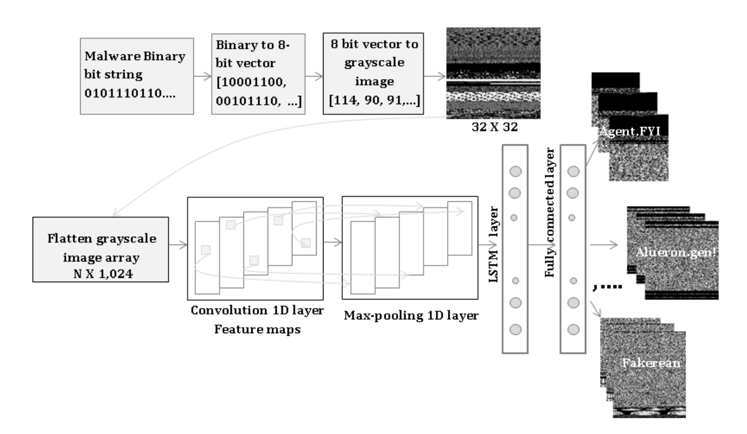
Static Analysis using Image detection techniques

Slide 54
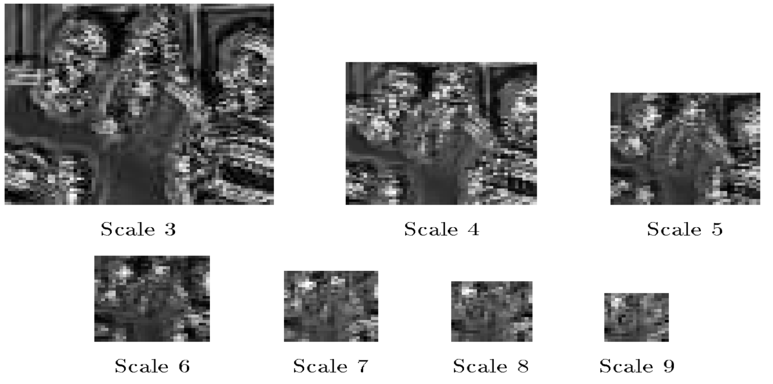
Static Analysis using Image detection techniques

Slide 55
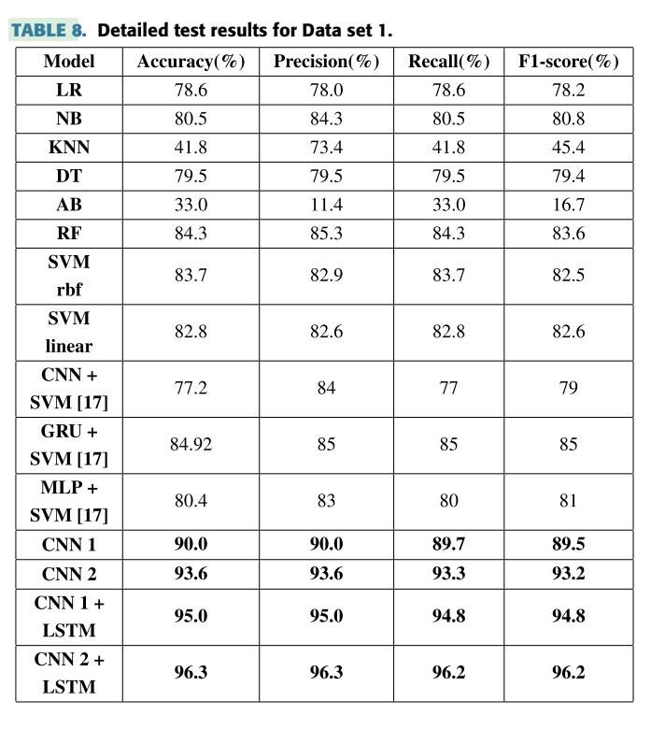
Static Analysis using Image processing techniques - results

Slide 56
Static Analysis using Image processing techniques - results
DIMD is an effective method for malware categorization in comparison to the existing methods.
Fast.
Avoid disassemblers and decompilers.
Immune to Packers.

Slide 57
THANKS!
ANY QUESTIONS?

Slide 58
References
K. Liu, H. B. K. Tan and X. Chen, "Binary Code Analysis," in Computer, vol. 46, no. 8, pp. 60-68, August 2013, doi: 10.1109/MC.2013.268.
M. Hassen, M. M. Carvalho and P. K. Chan, "Malware classification using static analysis based features," 2017 IEEE Symposium Series on Computational Intelligence (SSCI), Honolulu, HI, 2017, pp. 1-7, doi: 10.1109/SSCI.2017.8285426.
R. Vinayakumar, Mamoun Alazab, K. P. Soman, Prabaharan Poornachandran, Sitalakshmi Venkatraman:
Robust Intelligent Malware Detection Using Deep Learning. IEEE Access 7: 46717-46738 (2019)

